Slide 1

CLASSIFICATION OF SIGNIFICANT WATER RESOURCES AND DETERMINATION OF RESOURCE QUALITY OBJECTIVES FOR WATER RESOURCES IN THE USUTU TO MHLATHUZE CATCHMENTS (WP11387)
Project Steering Committee 1, Virtual: 7 June 2022

Slide 2
8.2.4 & 8.2.5
PRIORITISATION PROCESS (Rivers, Estuaries, Wetlands)
RIVER PRIORITIES (HOTSPOTS)
Delana Louw
Rivers for Africa

Slide 3
PRIORITY AREAS: APPROACH
Purpose of HOTSPOTS (HIGH OR VERY HIGH PRIORITY AREAS) – indicate areas where more detailed assessments than desktop or rapid is required.
Hotspots consider areas of ecological, socio-cultural and water resource use importance.
3
Notes:
GLeWaP - May 2010
3

Slide 4
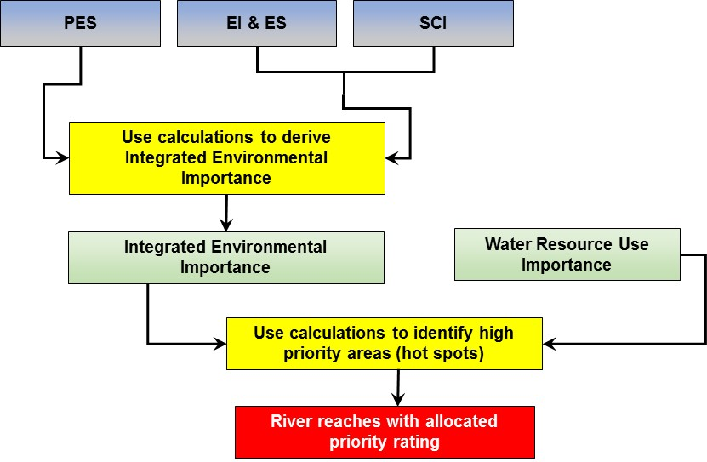
PRIORITY AREAS: APPROACH (cont)

Slide 5
W1 (Mhlathuze): Priority
IUA W12-a_(Upper Mhlathuze).
RU W12-3 Very High priority (WRUI)
IUA W12-b_(Mfule, Mhlatuzane, Nseleni)
IUA W12-c (Lower Mhlathuze).
RU W12-6, 8 Very High priority (WRUI)
IUA W12-d (Nhlabane)
IUA W12-e (Msingazi)
RU W12-9, 10 Very High RU priority (WRUI)
IUA W11 (Matigulu).
IUA W13 (Mlalazi)
Notes:
Caryn to do the scope, will be Tasks of study, deliverables, reference to previous ewr study, use some of following slides, but simplify

Slide 6
W2 (Umfolozi): Priority
IUA W23 (Upper Umfolozi incl Lower White & Black Umfolozi)
IUA W21 (Upper & Middle White Umfolozi).
RU W21-5 Very High Priority (IEI)
IUA W22_(Upper Black Umfolozi)
Notes:
Caryn to do the scope, will be Tasks of study, deliverables, reference to previous ewr study, use some of following slides, but simplify

Slide 7
W3 (Mkuze): Priority
IUA W31-a (Upper Mkuze)
Very High and High Priority (IEI)
IUA W31-b (Lower Mkuze)
Very High and High Priority (IEI)
IUA W32-a (Upper Hluhluwe)
Very High and High Priority (IEI)
IUA W32-b (Nyalezi & Mzinene)
Very High and High Priority (IEI)
Notes:
Caryn to do the scope, will be Tasks of study, deliverables, reference to previous ewr study, use some of following slides, but simplify

Slide 8
W4 (Pongola): Priority
IUA W42-a (Upper Pongola)
High Priority (IEI & WRUI)
IUA W42-b (Middle Pongola, Ithala).
High Priority (IEI & WRUI)
IUA W45 (Lower Pongola Floodplain)
Very High Priority (IEI & WRUI)
IUA W44 (Middle Pongola)
High Priority (WRUI)
IUA W41 (Bivane)
High Priority (IEI & WRUI)
Notes:
Caryn to do the scope, will be Tasks of study, deliverables, reference to previous ewr study, use some of following slides, but simplify

Slide 9
W5 (Usutu): Priority
IUA W52 (W5 Downstream major dams and Hlelo)
W RU 51-2, 3 Very High Priority (IEI & WRUI)
IUA W55 (Mpuluzi & Lusushwana).
IUA W51 (W5 Upstream Major Dams)
W RU 53-2, 54-1 Very High Priority (WRUI)
IUA W57 (Lower Usutu)
Very High Priority (IEI)

Slide 10
W7 (Kosi & Sibaya): Priority
IUA W70-a (Kosi)
Very High Priority (IEI & WRUI)
IUA W70-b (Sibaya)
Notes:
Caryn to do the scope, will be Tasks of study, deliverables, reference to previous ewr study, use some of following slides, but simplify

Slide 11
IEI
Priority

